Slide 1
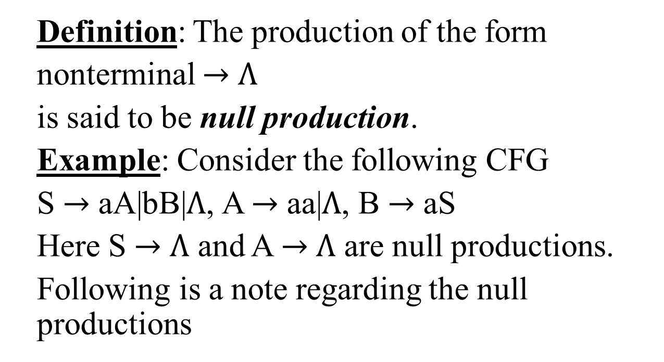
Null Production
Definition: The production of the form
nonterminal $→$ $Λ$
is said to be null production.
Example: Consider the following CFG
S $→$ aA|bB|$Λ$, A $→$ aa|$Λ$, B $→$ aS
Here S $→$ $Λ$ and A $→$ $Λ$ are null productions.
Following is a note regarding the null productions

Slide 2
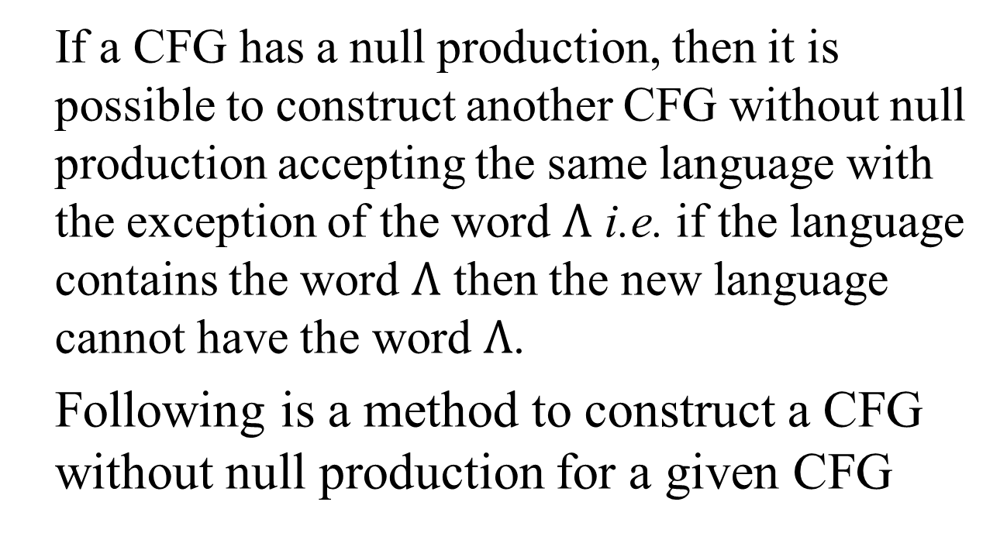
Note
If a CFG has a null production, then it is possible to construct another CFG without null production accepting the same language with the exception of the word $Λ$ i.e. if the language contains the word $Λ$ then the new language cannot have the word $Λ$.
Following is a method to construct a CFG without null production for a given CFG

Slide 3
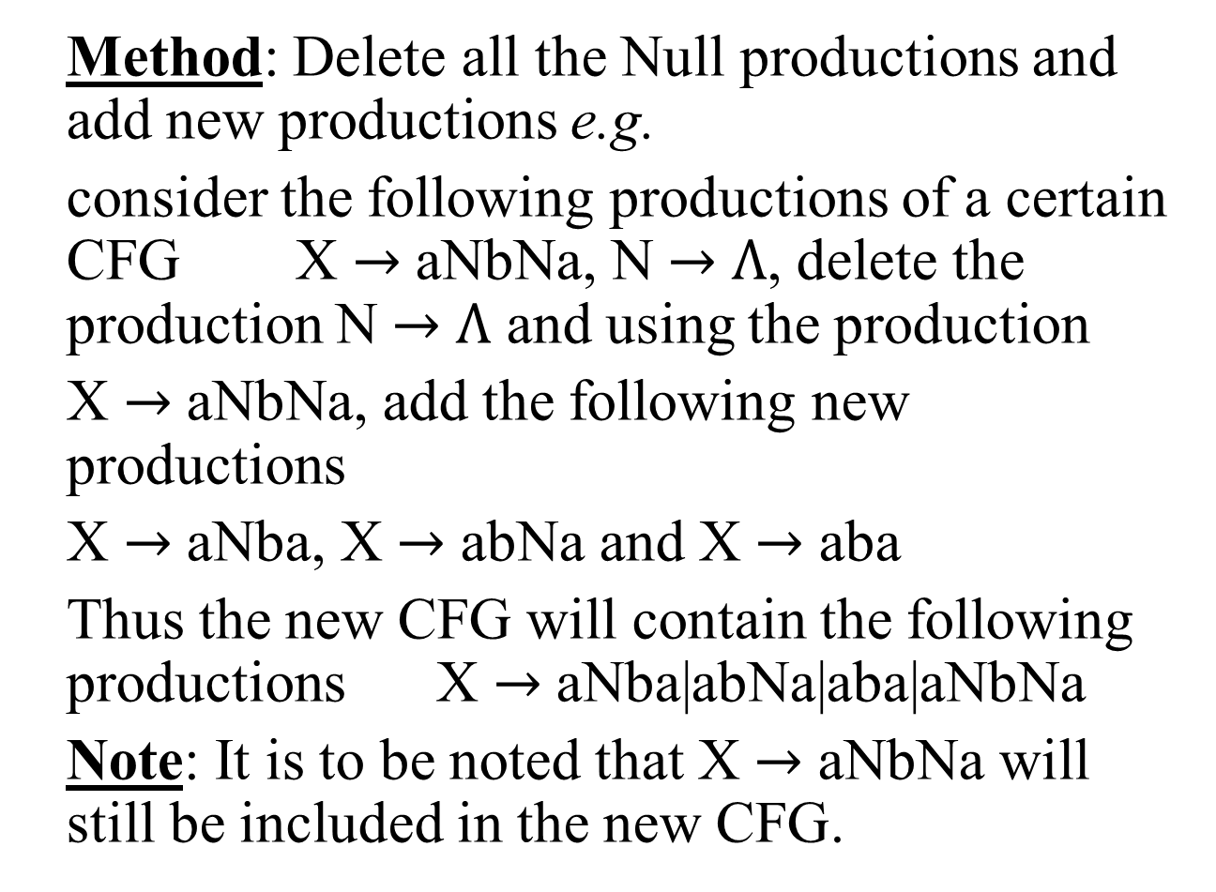
Null Production continued …
Method: Delete all the Null productions and add new productions e.g.
consider the following productions of a certain CFG X $→$ aNbNa, N $→$ $Λ$, delete the production N $→$ $Λ$ and using the production
X $→$ aNbNa, add the following new productions
X $→$ aNba, X $→$ abNa and X $→$ aba
Thus the new CFG will contain the following productions X $→$ aNba|abNa|aba|aNbNa
Note: It is to be noted that X $→$ aNbNa will still be included in the new CFG.

Slide 4
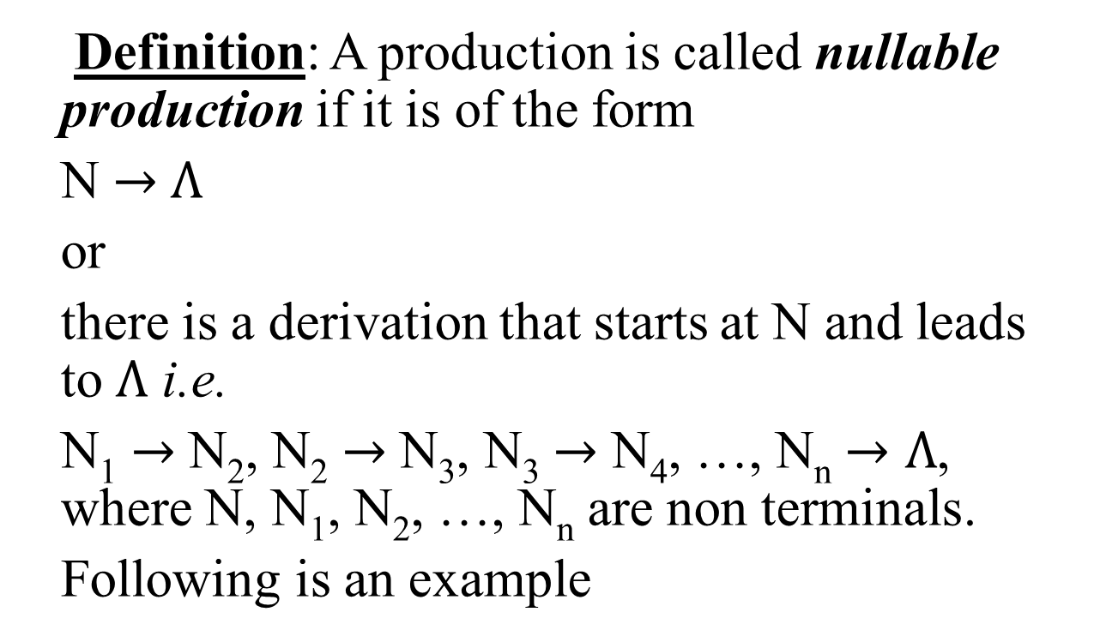
Nullable Production
Definition: A production is called nullable production if it is of the form
N $→$ $Λ$
or
there is a derivation that starts at N and leads to $Λ$ i.e.
N₁ $→$ N₂, N₂ $→$ N₃, N₃ $→$ N₄, …, N_{n} $→Λ$, where N, N₁, N₂, …, N_{n} are non terminals.
Following is an example

Slide 5
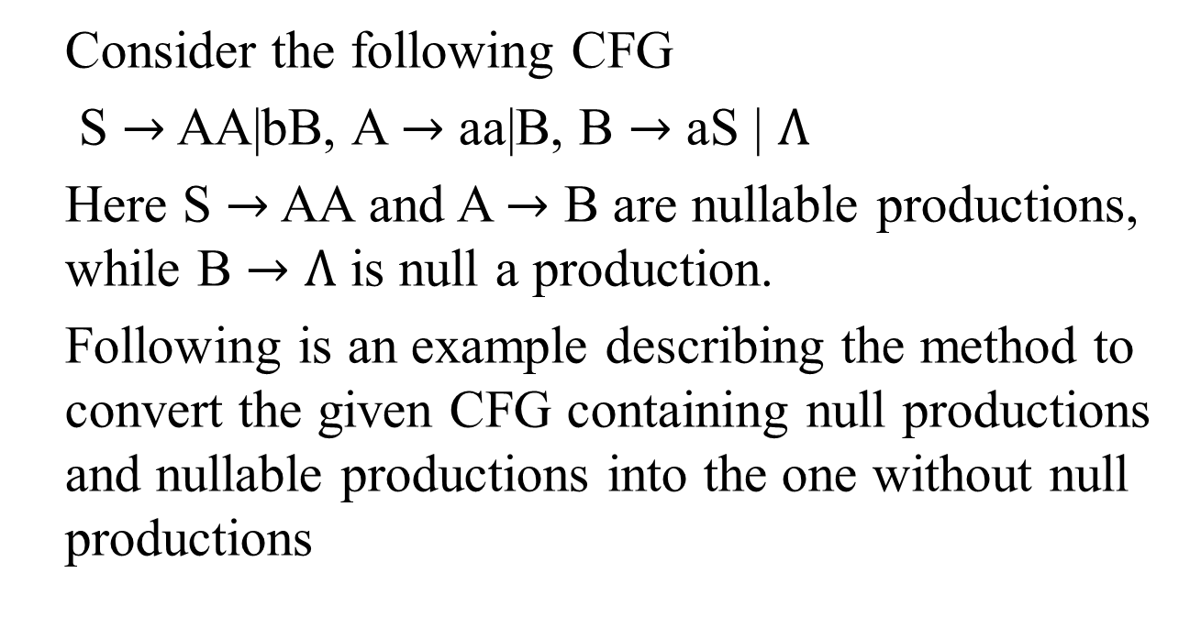
Example
Consider the following CFG
S $→$ AA|bB, A $→$ aa|B, B $→$ aS | $Λ$
Here S $→$ AA and A $→$ B are nullable productions, while B $→$ $Λ$ is null a production.
Following is an example describing the method to convert the given CFG containing null productions and nullable productions into the one without null productions

Slide 6
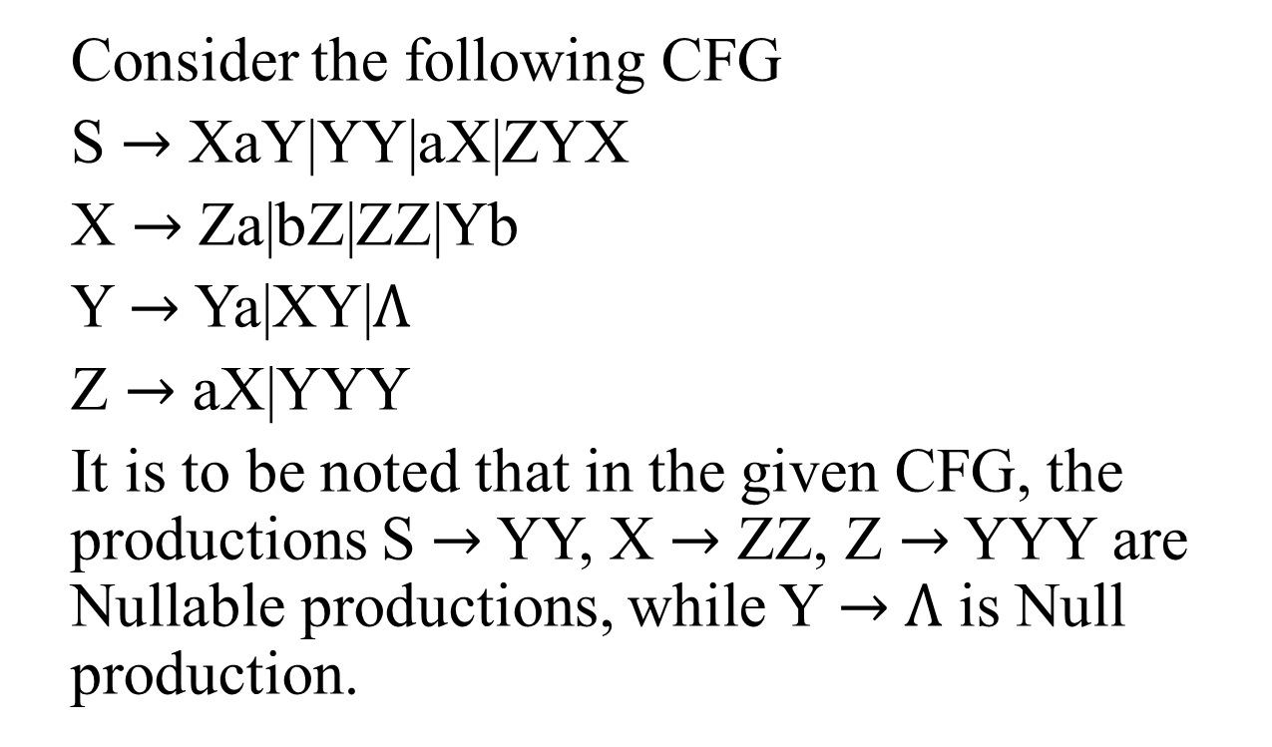
Example
Consider the following CFG
S $→$ XaY|YY|aX|ZYX
X $→$ Za|bZ|ZZ|Yb
Y $→$ Ya|XY|$Λ$
Z $→$ aX|YYY
It is to be noted that in the given CFG, the productions S $→$ YY, X $→$ ZZ, Z $→$ YYY are Nullable productions, while Y $→$ $Λ$ is Null production.

Slide 7
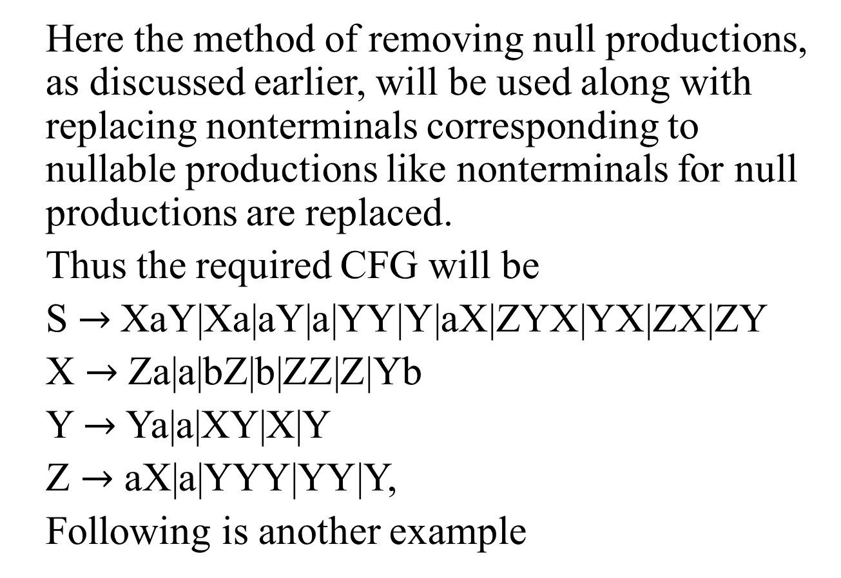
Example continued …
Here the method of removing null productions, as discussed earlier, will be used along with replacing nonterminals corresponding to nullable productions like nonterminals for null productions are replaced.
Thus the required CFG will be
S $→$XaY|Xa|aY|a|YY|Y|aX|ZYX|YX|ZX|ZY
X $→$ Za|a|bZ|b|ZZ|Z|Yb
Y $→$ Ya|a|XY|X|Y
Z $→$ aX|a|YYY|YY|Y,
Following is another example

Slide 8
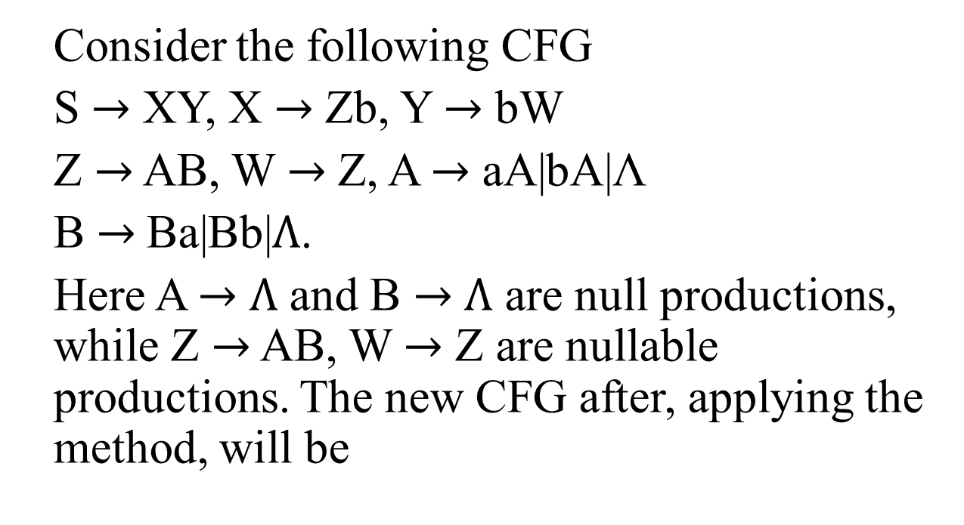
Example
Consider the following CFG
S $→$ XY, X $→$ Zb, Y $→$ bW
Z $→$ AB, W $→$ Z, A $→$ aA|bA|Λ
B $→$Ba|Bb|$Λ$.
Here A $→$ $Λ$ and B $→$ $Λ$ are null productions, while Z $→$ AB, W $→$ Z are nullable productions. The new CFG after, applying the method, will be

Slide 9
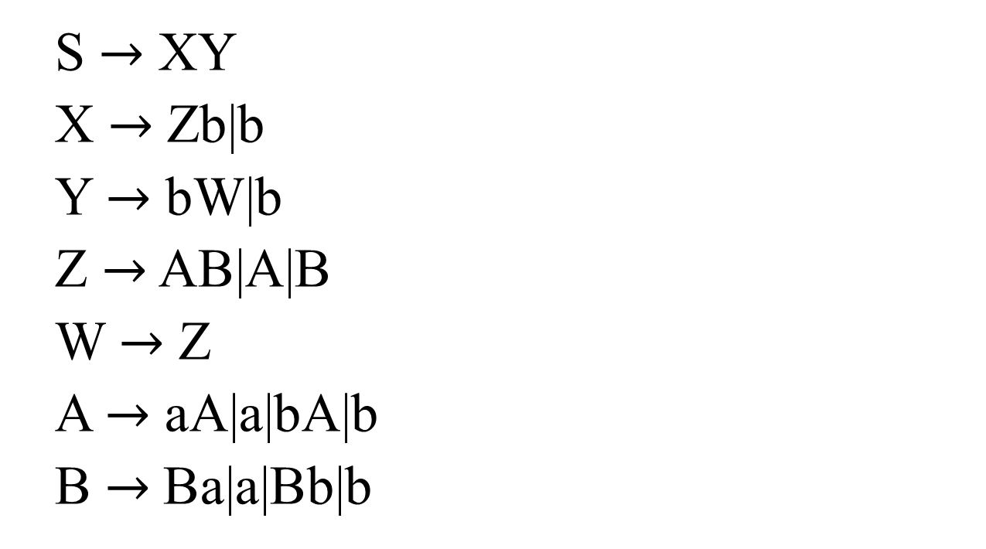
Example continued …
S $→$ XY
X $→$ Zb|b
Y $→$ bW|b
Z $→$ AB|A|B
W $→$ Z
A $→$ aA|a|bA|b
B $→$Ba|a|Bb|b

Slide 10
Note
While adding new productions all Nullable productions should be handled with care. All Nullable productions will be used to add new productions, but only the Null production will be deleted.

Slide 11
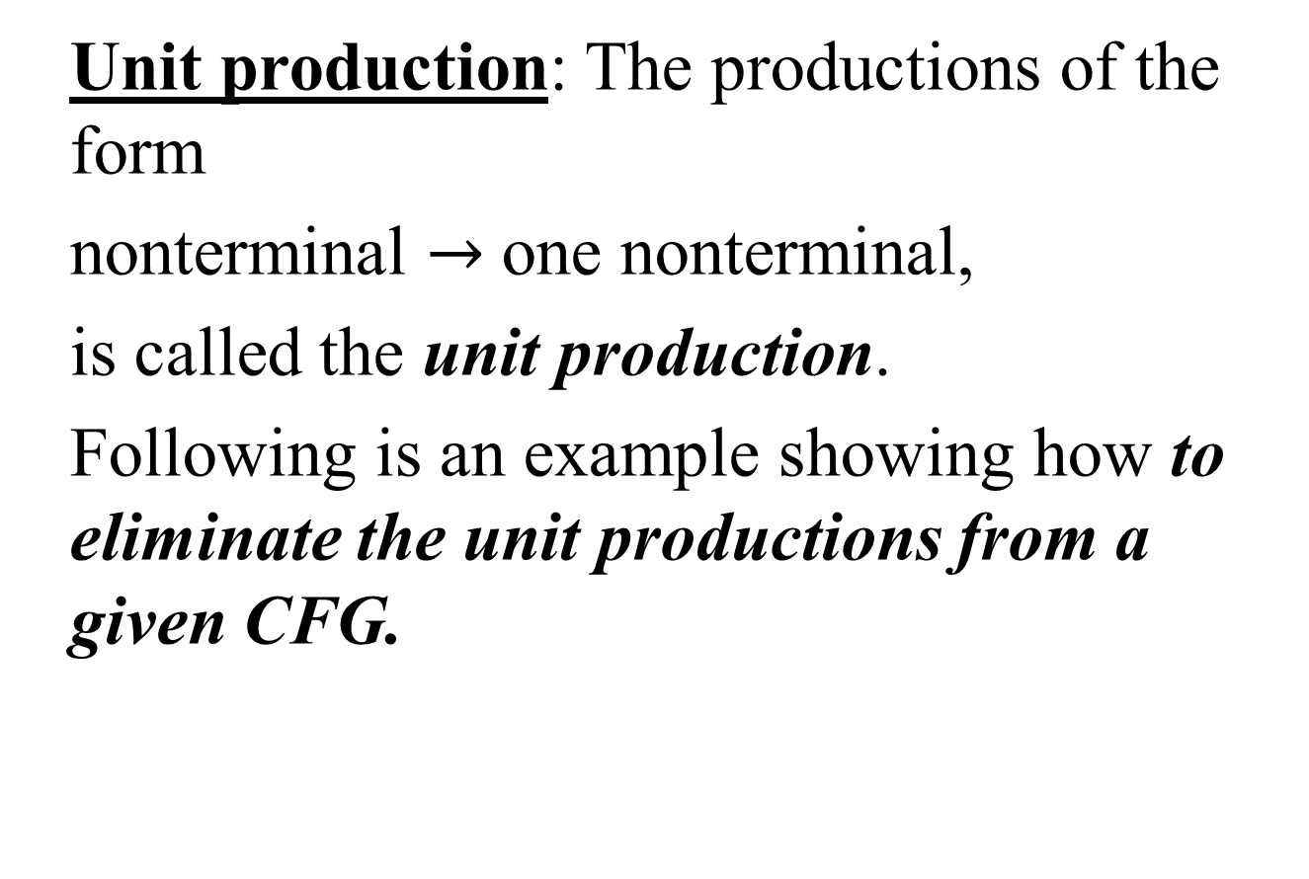
Unit production
Unit production: The productions of the form
nonterminal $→$ one nonterminal,
is called the unit production.
Following is an example showing how to eliminate the unit productions from a given CFG.

Slide 12
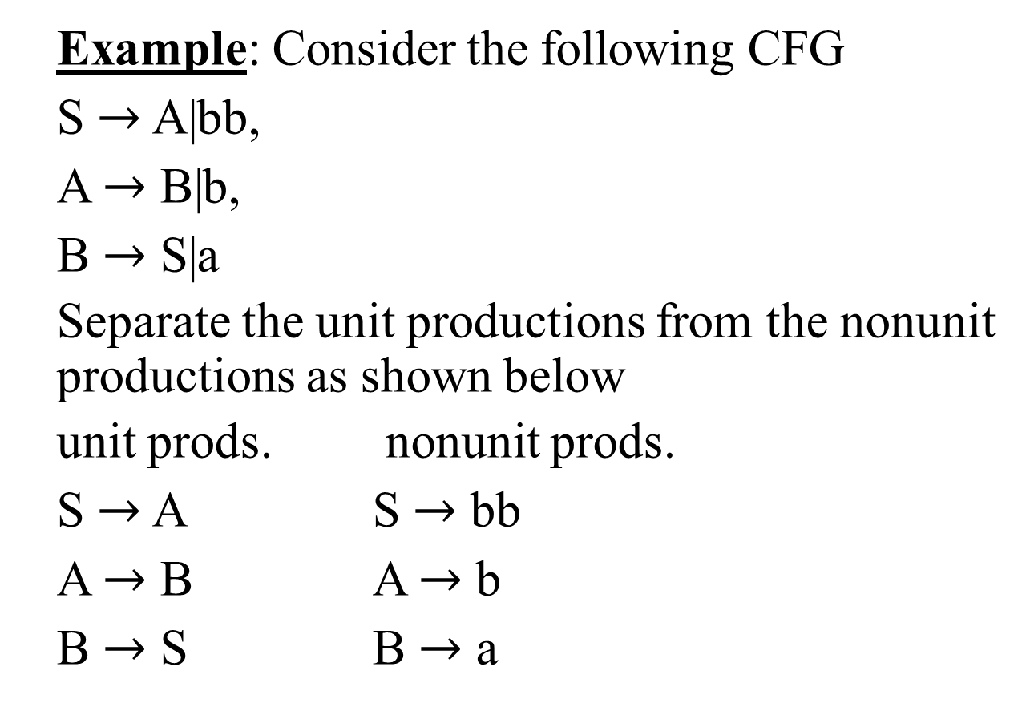
Unit production continued …
Example: Consider the following CFG
S $→$ A|bb,
A $→$ B|b,
B $→$ S|a
Separate the unit productions from the nonunit productions as shown below
unit prods. nonunit prods.
S $→$ A S $→$ bb
A $→$ B A $→$ b
B $→$ S B $→$ a

Slide 13
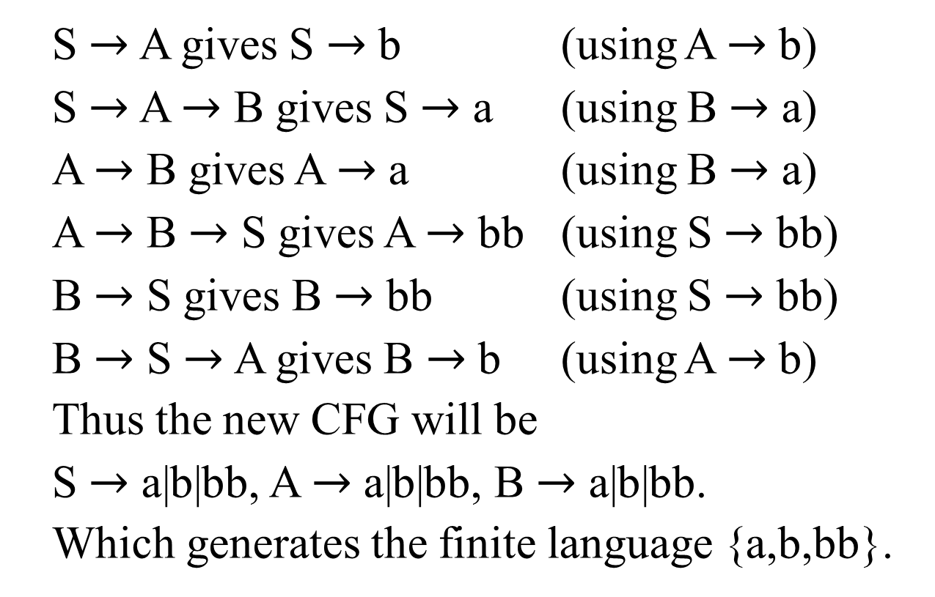
Example continued …
S $→$ A gives S $→$ b (using A $→$ b)
S $→$ A $→$ B gives S $→$ a (using B $→$ a)
A $→$ B gives A $→$ a (using B $→$ a)
A $→$ B $→$ S gives A $→$ bb (using S $→$ bb)
B $→$ S gives B $→$ bb (using S $→$ bb)
B $→$ S $→$ A gives B $→$ b (using A $→$ b)
Thus the new CFG will be
S $→$ a|b|bb, A $→$ a|b|bb, B $→$ a|b|bb.
Which generates the finite language {a,b,bb}.

Slide 14

Unit production continued …
Example: Consider the following CFG
S $→$ AB,
A $→$ a,
B $→$ b |C
C $→$D
D $→$E
E $→$a

Slide 15
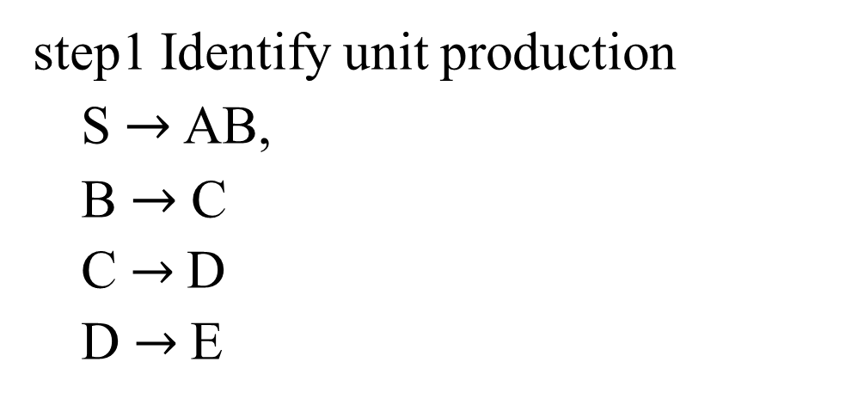
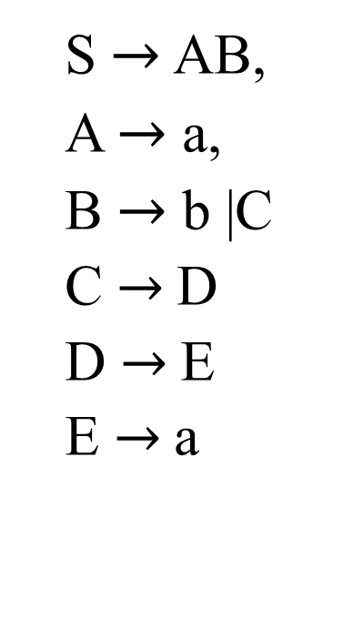
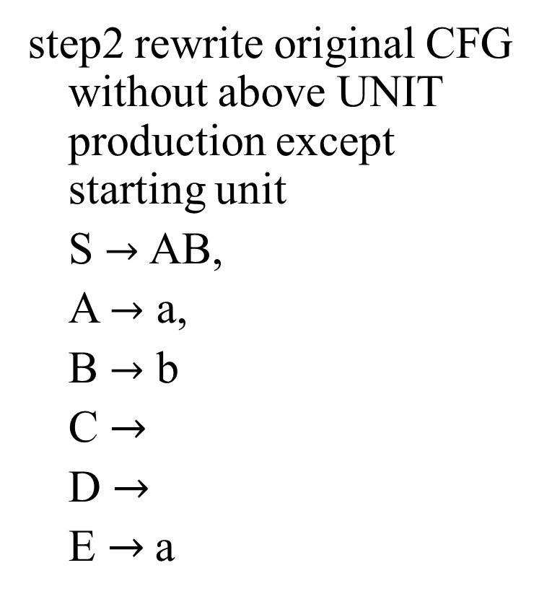
Example continued …
step1 Identify unit production
S $→$ AB,
B $→$C
C $→$D
D $→$E
S $→$ AB,
A $→$ a,
B $→$ b |C
C $→$D
D $→$E
E $→$a
step2 rewrite original CFG without above UNIT production except starting unit
S $→$ AB,
A $→$ a,
B $→$ b
C $→$
D $→$
E $→$a

Slide 16
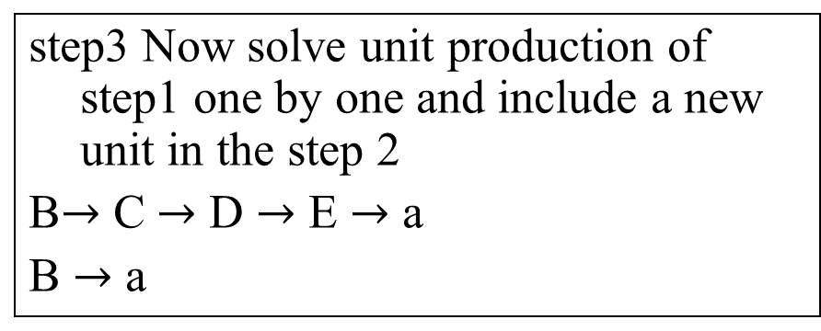
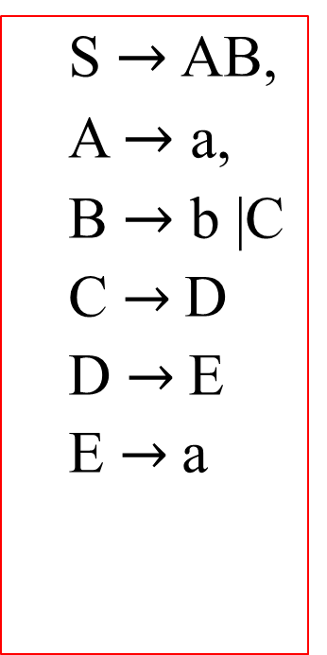
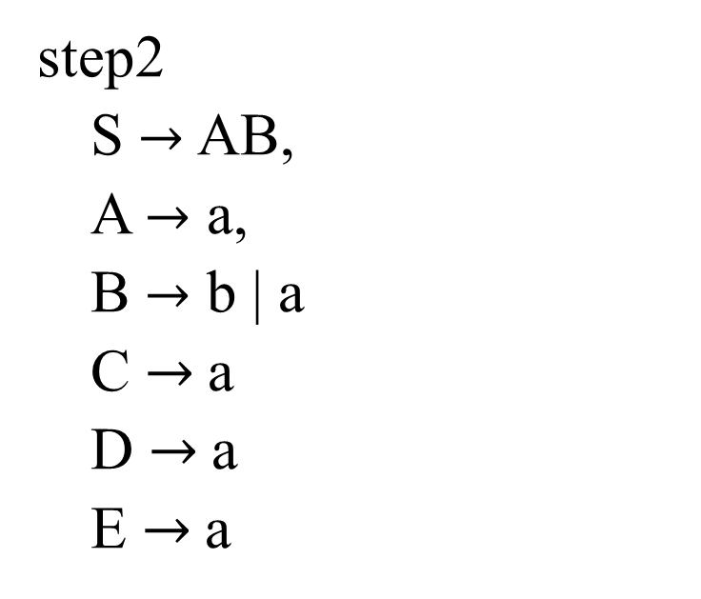
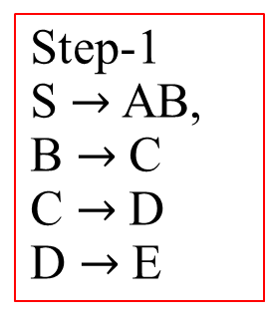
Example continued …
Step-1
S $→$ AB,
B $→$C
C $→$D
D $→$E
step3 Now solve unit production of step1 one by one and include a new unit in the step 2
B$→$ C $→$ D $→$ E $→$ a
B $→$ a
S $→$ AB,
A $→$ a,
B $→$ b |C
C $→$D
D $→$E
E $→$a
step2
S $→$ AB,
A $→$ a,
B $→$ b | a
C $→$a
D $→$a
E $→$a

Slide 17
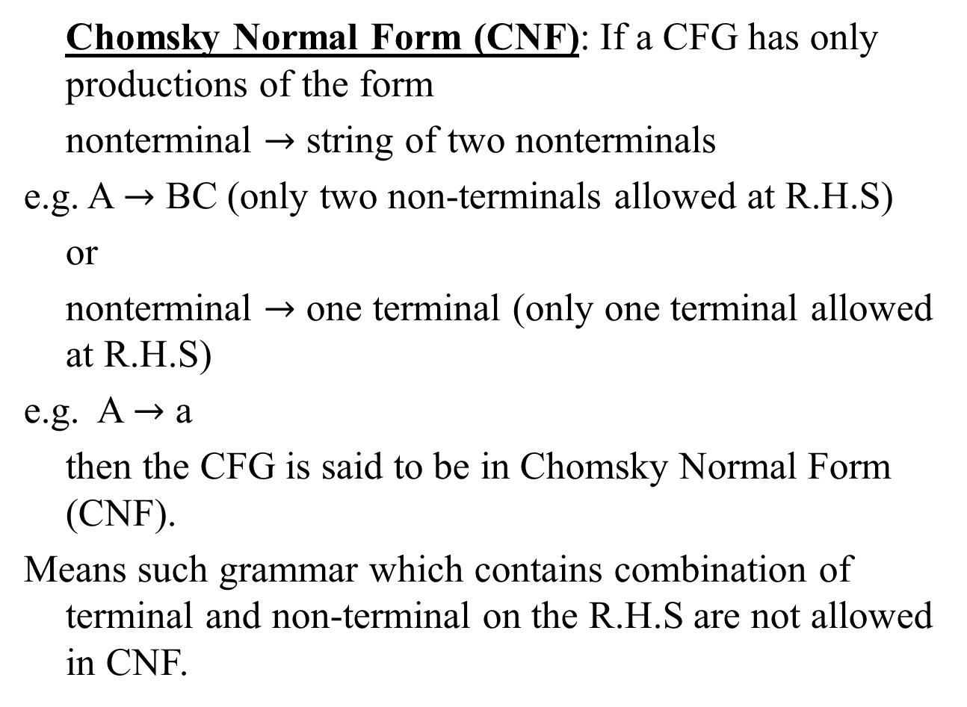
Chomsky Normal Form
Chomsky Normal Form (CNF): If a CFG has only productions of the form
nonterminal $→$ string of two nonterminals
e.g. A $→$ BC (only two non-terminals allowed at R.H.S)
or
nonterminal $→$ one terminal (only one terminal allowed at R.H.S)
e.g. A $→$ a
then the CFG is said to be in Chomsky Normal Form (CNF).
Means such grammar which contains combination of terminal and non-terminal on the R.H.S are not allowed in CNF.

Slide 18
Summing Up
Examples of building TG’s corresponding to the Regular Grammar, Null productions with examples, Nullable productions with examples, Unit production with example, Chomsky Normal Form (Definition)

